Slide 1
What is a Survey Paper?
Portions of this PPT draw from PPT authored by Jennifer Wong

Slide 2
A survey paper is…
"a paper that summarizes and organizes recent research results in a novel way that integrates and adds understanding to work in the field. A survey article assumes a general knowledge of the area; it emphasizes the classification of the existing literature, developing a perspective on the area, and evaluating trends."
As described by ACM Computing Surveys

Slide 3
Goals of a Survey
Provide reader with a view of existing work that is well organized and comprehensive
Not all details must be included, which one’s should/shouldn’t?
Make sure to cover all relevant material completely
Logical structure of organization
State-of-the-art view

Slide 4
Your survey paper should …
Summarize the research in 5-8 papers on a particular topic
Include your own commentary on the significance of the approach and the solutions presented in each paper
Provide a critical assessment of the work that has been done
Include a discussion on future research directions
REMEMBER
Everything you write in this survey paper has to be in your own words
All ideas, paraphrases of other people's words must be correctly attributed in the body of the paper and in the references
Any evidence of it in the survey paper will result in a fail grade

Slide 5
How To Find Articles
Search various digital libraries
ACM
IEEE
Google Scholar
Try to identify research groups/faculty in the area
Dig into their work and pointers
Authors’ home pages
Or polite request
Search conference website (conference program)

Slide 6
How To Pick Articles – In General
When picking papers to read - try to:
Pick a recent survey of the field so you can quickly gain an overview,
Pick a paper that you can easier understand – book chapters often give easier understandable materials and lengthy explanation that may give you a head start, although they may not be as up-to-date as papers,
Pick papers that are related to each other in some ways and/or that are in the same field so that you can write a meaningful survey out of them,
Favour papers from well-known journals and conferences,
Favour “first” or “foundational” papers in the field (as indicated in other people’s survey paper),
Favour more recent papers,
Once you have identified an interesting technology to report upon, follow developments in that strand of technology (e.g. time-wise and technology-wise developments).
Find relationships with respect to each other and to your topic area (classification scheme/categorization)

Slide 7
Article Structure
It should not be just a concatenation of paper reviews
A typical structure of a paper includes:
Title
Abstract
Introduction
Body of paper
Conclusion/Future Work
References

Slide 8
Article Structure
Introduction
Importance and significance of the topic
Discuss the background and target audience
Summarize the surveyed research area and explain why the surveyed area has been studied
Summarize the classification scheme you used to do the survey
Summarize the surveyed techniques with the above classification scheme

Slide 9
Article Structure
Survey details/Body of paper
Present the surveyed techniques using the classification scheme in detail
Identify the trends in the surveyed area. Give evidences for your decision
Identify some leading research/products/companies/web-sites
Identify the unresolved problems/difficulties, and future research issues

Slide 10
Article Structure
Conclusions/Future work
Summarize the conclusions of your survey
References
List all the citations referenced in your paper

Slide 11
Figures
Can be taken from papers as long as appropriate credit is given
“Figure taken from [28]”.
Draw your own figures to show classification or structure of the survey
Use tables to organize comparisons between applications/systems/etc

Slide 12
Example: IEEE S&T
A Survey of Security Issues In Wireless Sensor Networks, IEEE Communications Surveys and Tutorial, VOLUME 8, NO. 2, 2006

Slide 13
Paper Structure
Introduction
Background
Attack in Sensor Network
Cryptography in WSNs
Key Management Protocols
Secure Routing Protocols
Secure Data Aggregation
Intrusion Detection
Security in WSNs: Future Directions
Summary

Slide 14
Some tips
Organization of the article’s structure is the key
Your goal is to write for other to understand but not only yourselves.
State clearly what’s new you had brought in the technical community
Is you survey just yet another one?
Use comparative tables and figures
Avoid long, bland paragraphs
Do you really Think about the surveyed materials
Put your own thoughts, that is the contribution.

Slide 15
How to Cite a Reference
Cite the full info about the paper
Author names
Paper title
Publication details
Page numbers
Year, etc
In the text, use "[1]" to refer
[1] Adomavicius G, Tuzhilin A., “Toward the Next Generation of
Recommender Systems: A Survey of the State-of-the-Art and Possible
Extensions”, IEEE Transactions on Knowledge and Data Engineering,
Vol. 17, No. 6. (June 2005), pp. 734-749.
There are many bibliography formats. Select one and stick to it.
http://standards.ieee.org/guides/style/2009_Style_Manual.pdf (Chap 19)
http://sgs.umkc.edu/pdfs/ACM-STYLE-EXAMPLES.pdf

Slide 16
General Rules for Bibliography
Avoid use of et al. in a bibliography unless list is very long (five or more authors).
Internet drafts must be marked ``work in progress''.
Book citations include publication years, but no ISBN number.
It is now acceptable to include URLs to material, but it is probably bad form to include a URL pointing to the author's web page for papers published in IEEE and ACM publications, given the copyright situation. Use it for software and other non-library material. Avoid long URLs; it may be sufficient to point to the general page and let the reader find the material. General URLs are also less likely to change.
Leave a space between first names and last name, i.e., "J. P. Doe", not "J.P.Doe".

Slide 17
What not to do….

Slide 18
What not to do….

Slide 19
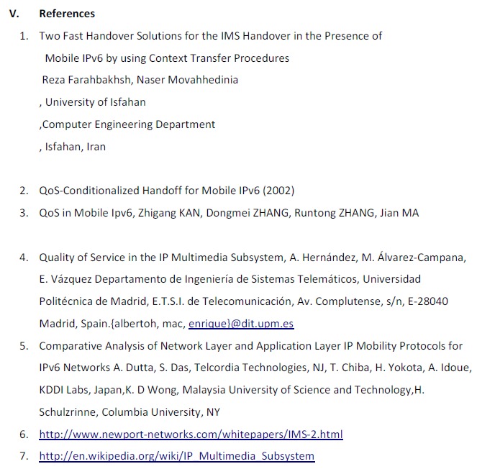
What not to do….

Slide 20
Are you ready to become a good researcher or engineer?
A few words
Understanding others’ work is more important than knowing yours
Before starting propose a solution, make a survey
You need to read a lot
Your work is always built on others
A good comparative study is always the key to open the door to building a good solution, publishing your work in top conferences and journals, and earning grants from your company.
Good documentation and notation habits make your easier to the path of success
Using good tools to assist you
You need a lot resources to build your technical report

